Slide 1
Better Credit Bureau - BCB
A BCDV1014 - DAPP2 capstone project presentation (a hyper ledger fabric approach to credit monitoring)
Shivam Rattan (GBC Blockchain development course - 2020-21 - Student id: 101339648)

Slide 2

About Me
- 7 years of international multi-disciplinary experience in IT and Telecom
- Blockchain and Full Stack development from GBC
- Email: shivam.rattan@georgebrown.com
- LinkedIn: https://www.linkedin.com/in/shivamrattan/
- GitHub: https://github.com/shivamrulz

Slide 3
Current CreditCard monitoring System
- 3 major credit bureaus (Equifax, TransUnion and Experian)
- 3 major credit card companies (ViSA, MasterCard, American Express)
- 2 major flaws:
1. Isolated: Even within a country the bureaus don’t share, international sharing is farfetched.
2. Costly: $20 per month for monitoring credit score per bureau: totalling to $500 per year.

Slide 4
Story time: There once was a new immigrant name Shivam who applied for a Canadian credit card.
Question: How many months did it take Shivam to get his first Canadian Credit card?

Slide 5
Answer: 3 months
- First for applying and waiting on the results (thanks to Covid)
- Second for discovering an issue with the credit report, and mailing TransUnion supporting information to fix adverse credit report
- Third for reapplying with ‘corrected’ information

Slide 6
What Exists…

Slide 7
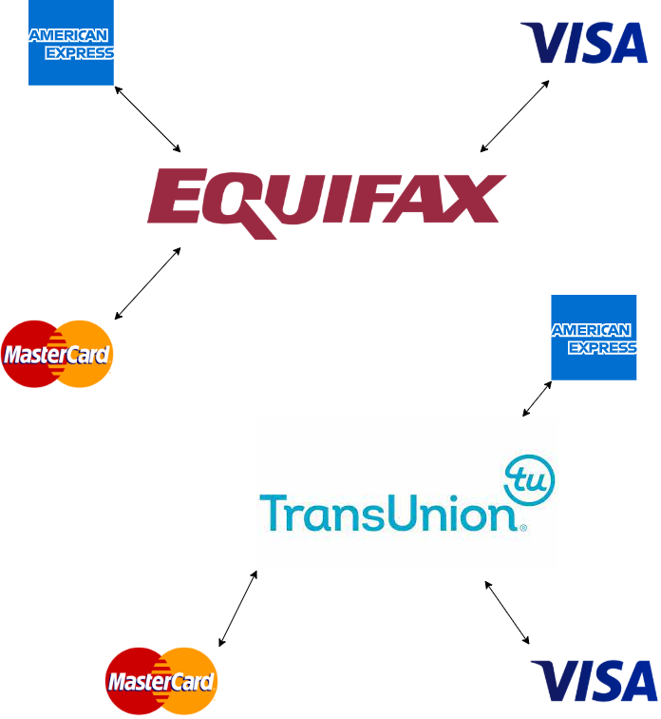
…Canada has only 2 bureaus, other countries have 3, imagine the disconnected world we live in

Slide 8
What should Exist!

Slide 9
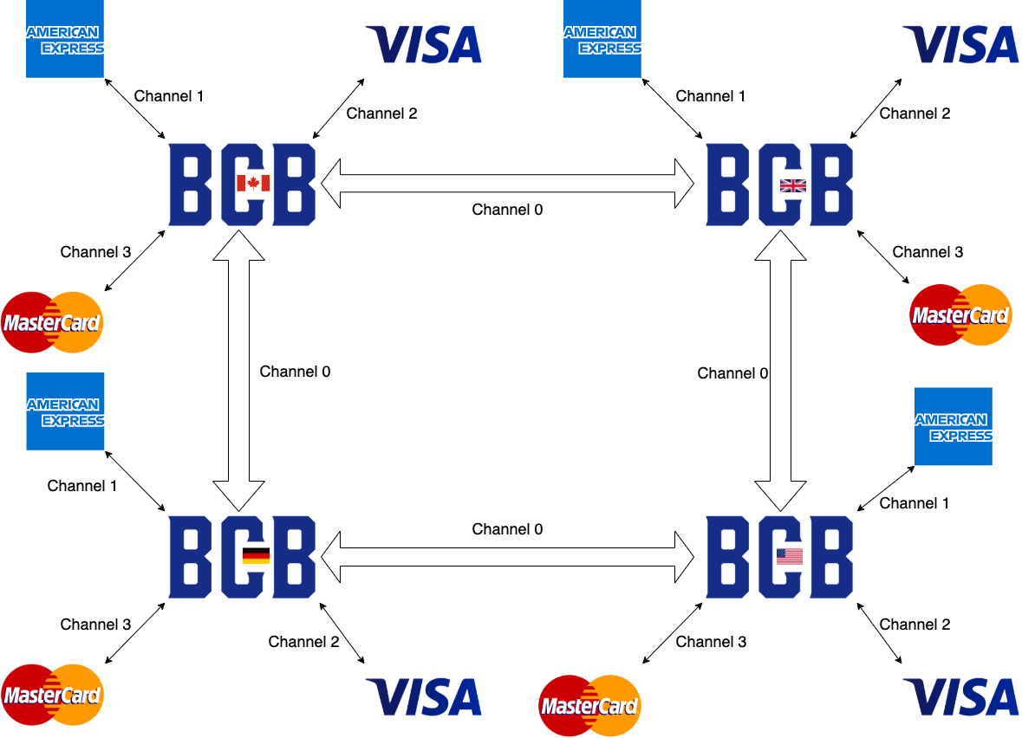

Slide 10
BCB (Better Credit Bureau) - A Hyperledger fabric approach to credit monitoring
- Globally 5,000 CC transactions happen per second; HLF blockchain supports up to 13,000
- Private Permissioned nature of HLF provides RBAC, immutability, and security, while not compromising on speed
- 1 BCB account per earthling

Slide 11
Key Benefits
- Credit history gets internationally synchronised
- Prevents frauds
- Global standardisation accelerates credit adoption in emerging markets

Slide 12
Market Opportunity
- Equifax and TU charge $20 monthly fee. Every Canadian checks their credit score at least once an year. 25,000,000 Canadians over 17 imply a $5 billion yearly revenue.
- Long-term: The Hyperledger fabric technology’s flexibility allows for global scalability, open to earn trillions of $.
- Short-term: The technology can be acquired by competition and integrated within their platform, potentially for millions of dollars.

Slide 13
Mockups

Slide 14
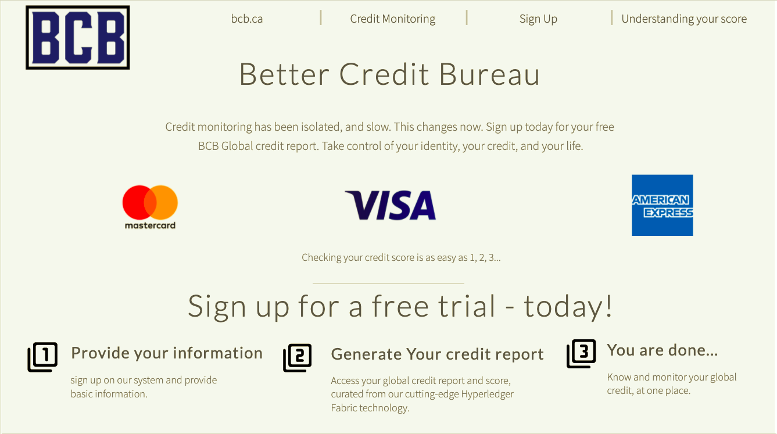

Slide 15
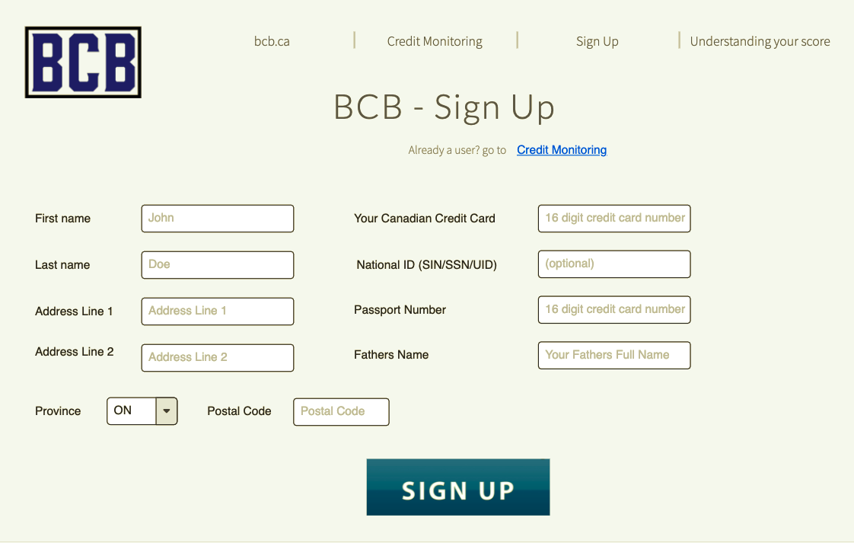

Slide 16
